Slide 1
Cavin-2 and -3 as tumour suppressors in prostate cancer
Lab Meeting 11/09/15
Amanda Oliver

Slide 2

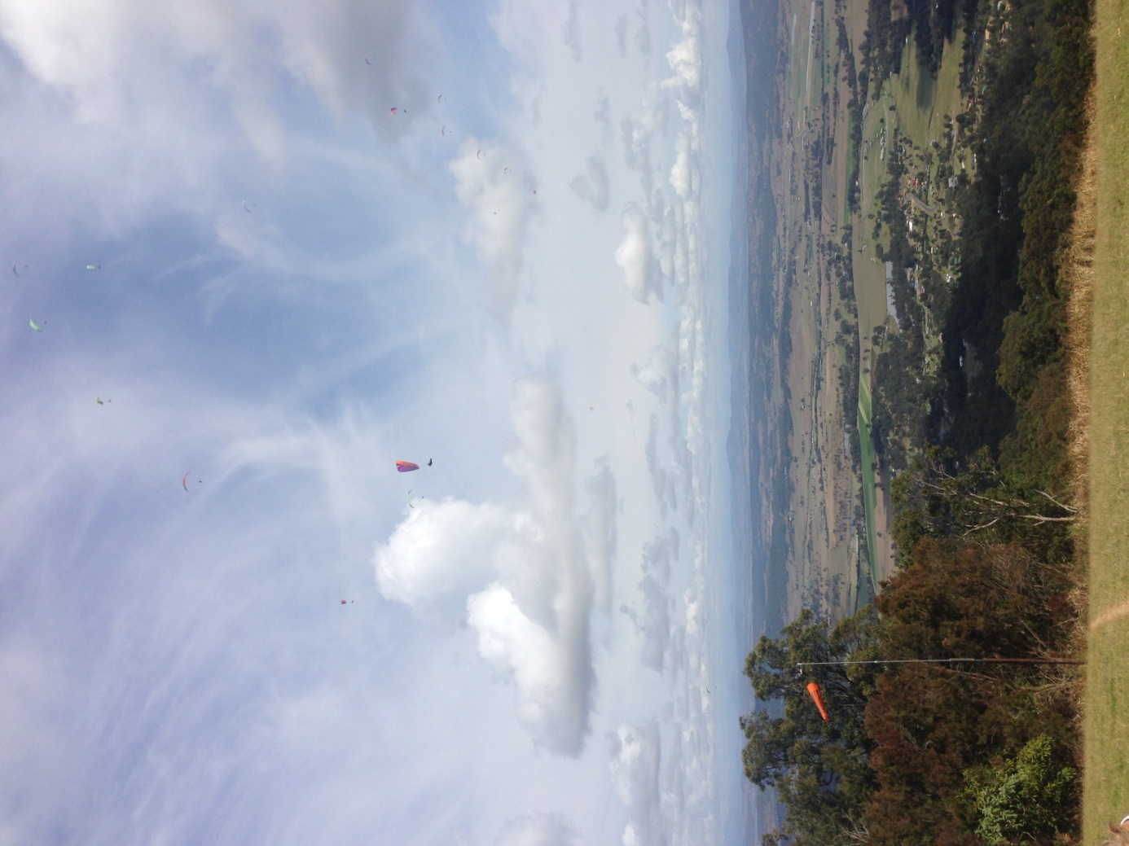


Slide 3
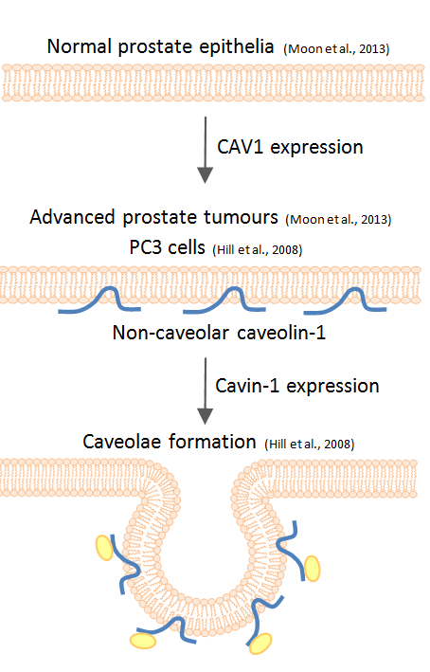
Caveolar proteins
Caveolae – small invaginations in lipid rafts
Caveolins and cavins involved in formation
Caveolin-1 (CAV1) and cavin-1 are essential for formation (Hill et al. 2008)
CAV1 expression increases tumourigenesis in prostate cancer cells
Cavin-1 attenuates CAV1 tumour promotion (Moon et al. 2013)

Slide 4
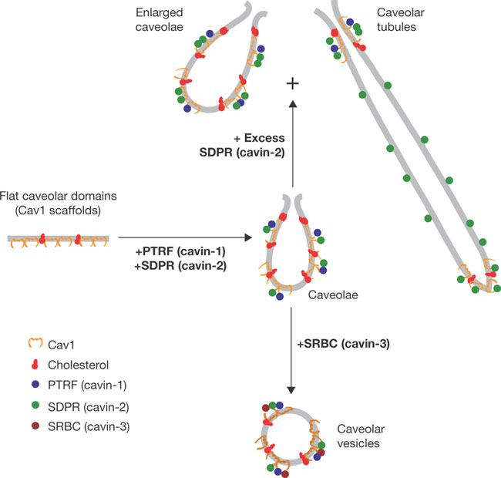
Cavin-2 and -3 in cancer
In caveolae:
Cavin-2 involved in tubulation and elongation
Cavin-3 involved in internalisation and trafficking
Both are down regulated in various cancers
Cavin-2 expression (mRNA and protein levels) down regulated in prostate cancer tissues compared to normal (Altintas et al., PLoS One 2013, Li et al., Cancer Science 2008)
Cavin-3 downregulated by promoter hypermethylation in prostate cancer cell lines compared to normal prostate epithelia (Mishra et al., Mol. Cancer Ther. 2010)

Slide 5
Recap
Cavin-2 ↓ in PCa epithelia (ns) and stroma
Cavin-3 ↓ in PCa epithelia and stroma
Cavin-2 and -3 not expressed in most prostate cancer cell lines
Cavin-2 and -3 expression in PC3 cells (+CAV1, - cavin-1) decreased
Migration
Proliferation
Anchorage independent growth
Mechanism?

Slide 6
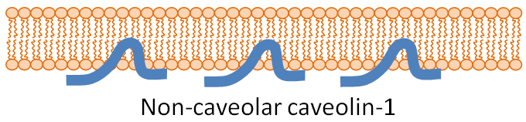
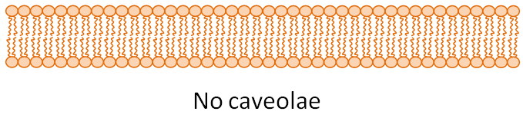
PC3 and LNCaP cell lines
PC3 – CAV1 but no cavin-1
LNCaP – no CAV1 or cavin-1
PC3 cells
LNCaP CAV1 cells
– CAV1
LNCaP cells
PC3 shCAV1 cells

Slide 7
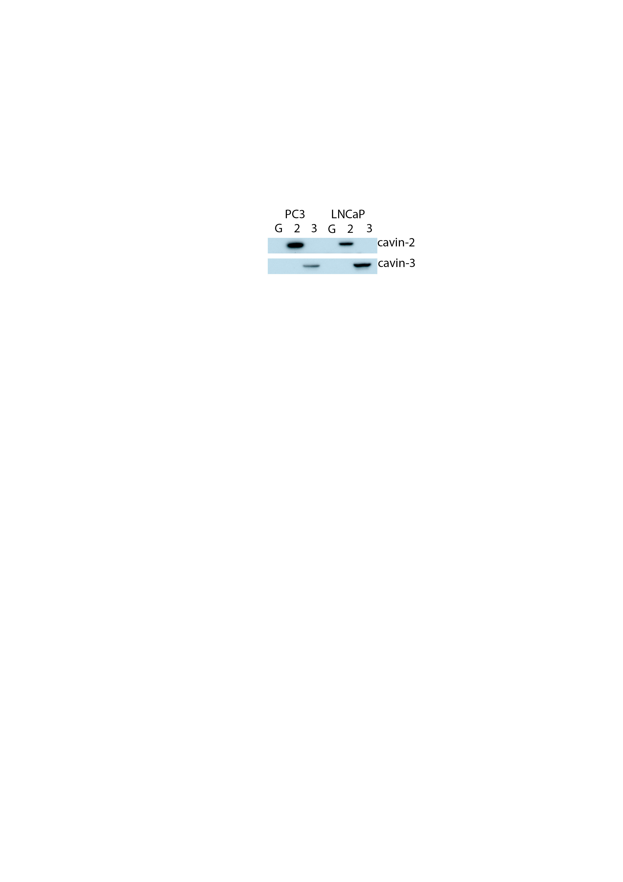
LNCaP proliferation
PC3 proliferation
Caveolin-1 negative
Cavin-1 negative

Slide 8
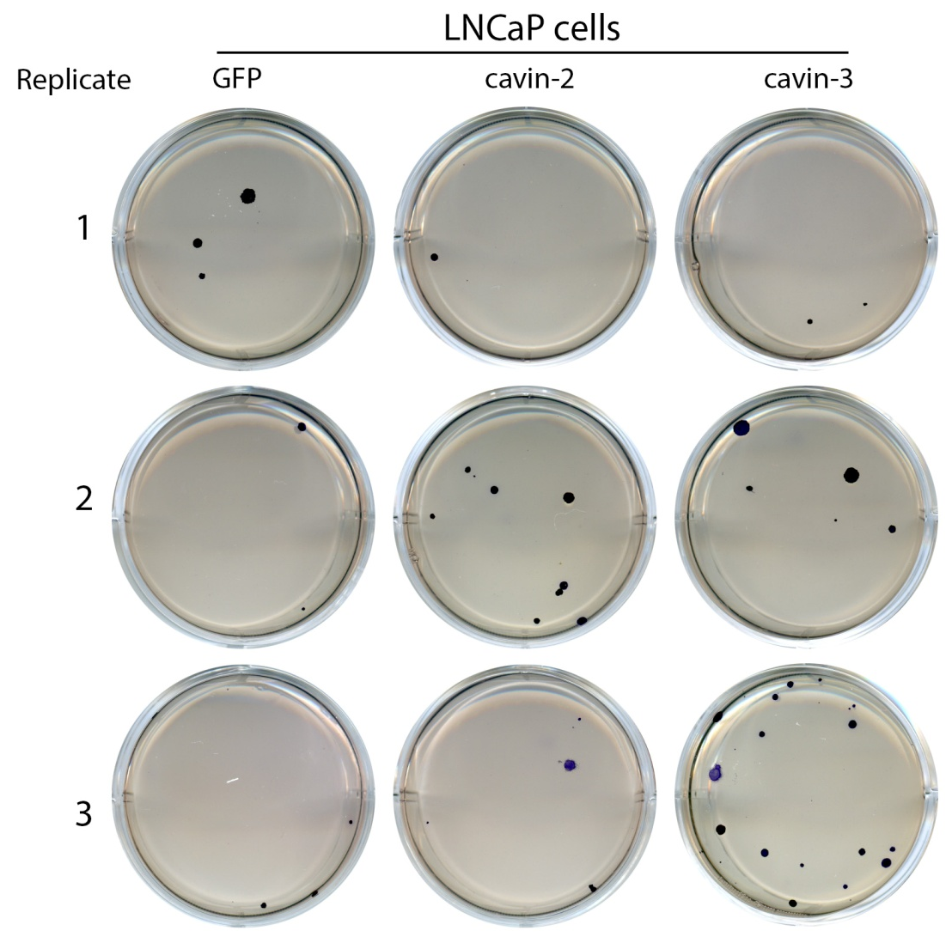
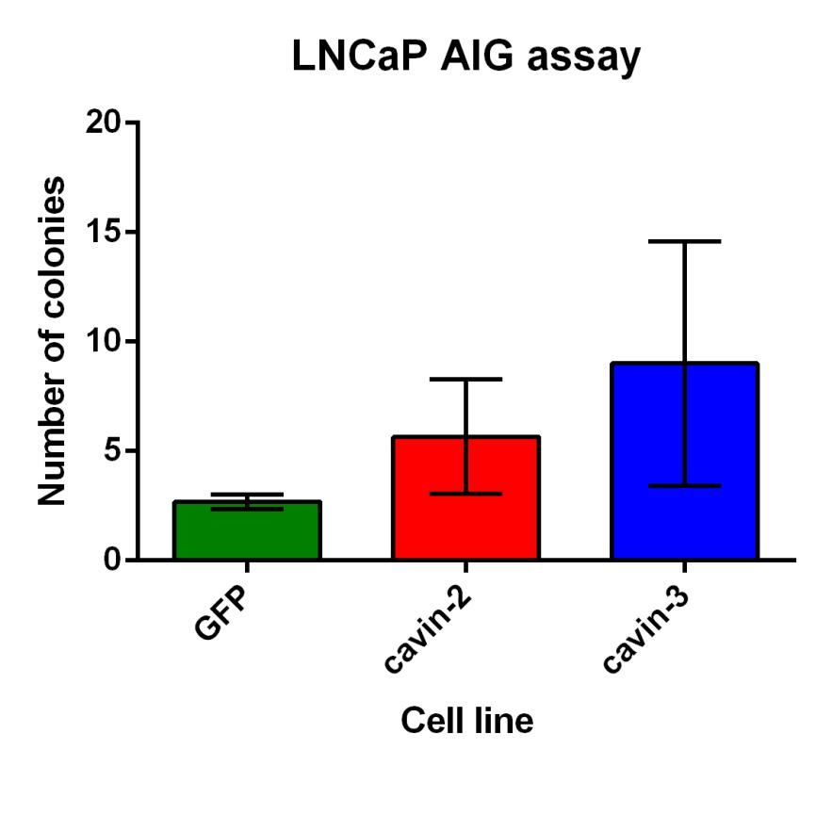
Anchorage independent growth
Caveolin-1 negative
Cavin-1 negative

Slide 9
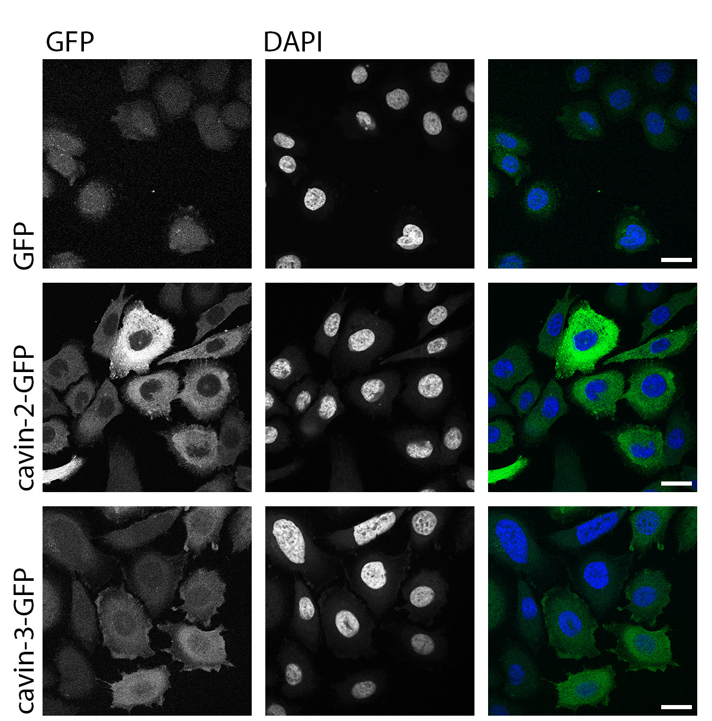
PC3 cells
Scale = 20μm
Caveolin-1 positive
Cavin-1 negative

Slide 10
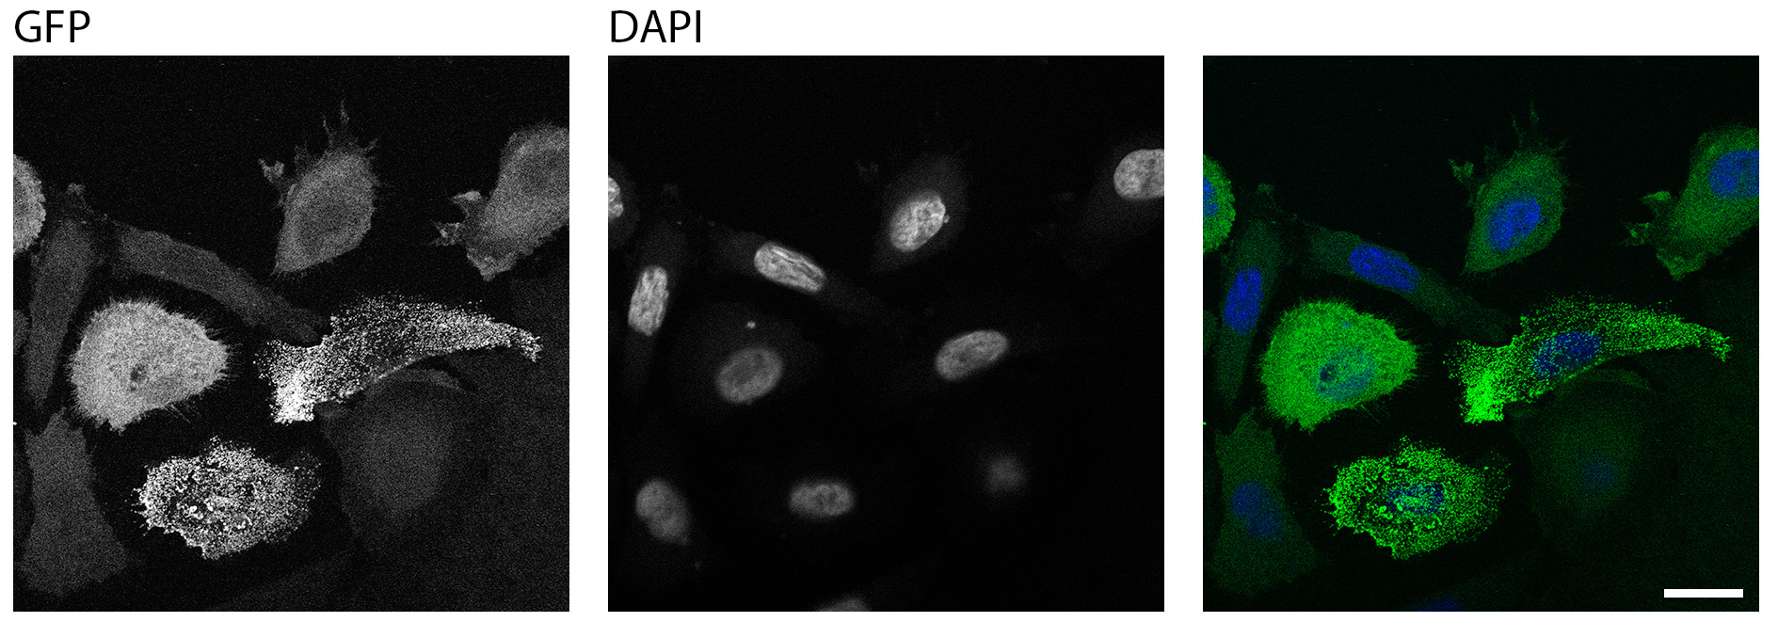
PC3 cavin-3 (NOT REPRESENTATIVE)
Caveolae?
Caveolin-1 positive
Cavin-1 negative
Scale = 20μm

Slide 11
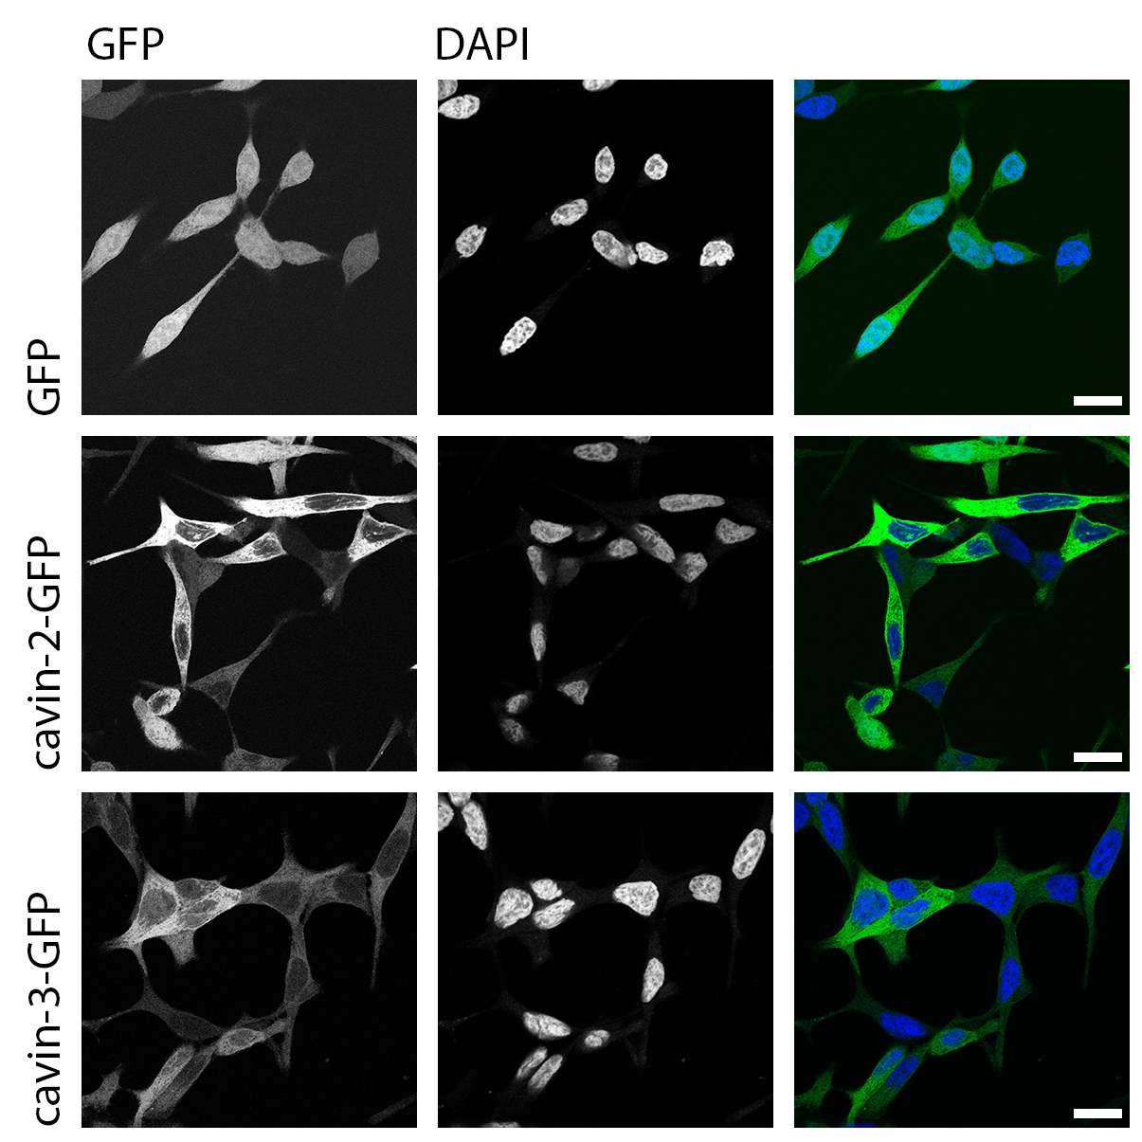
LNCaP cells
Scale = 20μm
Caveolin-1 negative
Cavin-1 negative

Slide 12
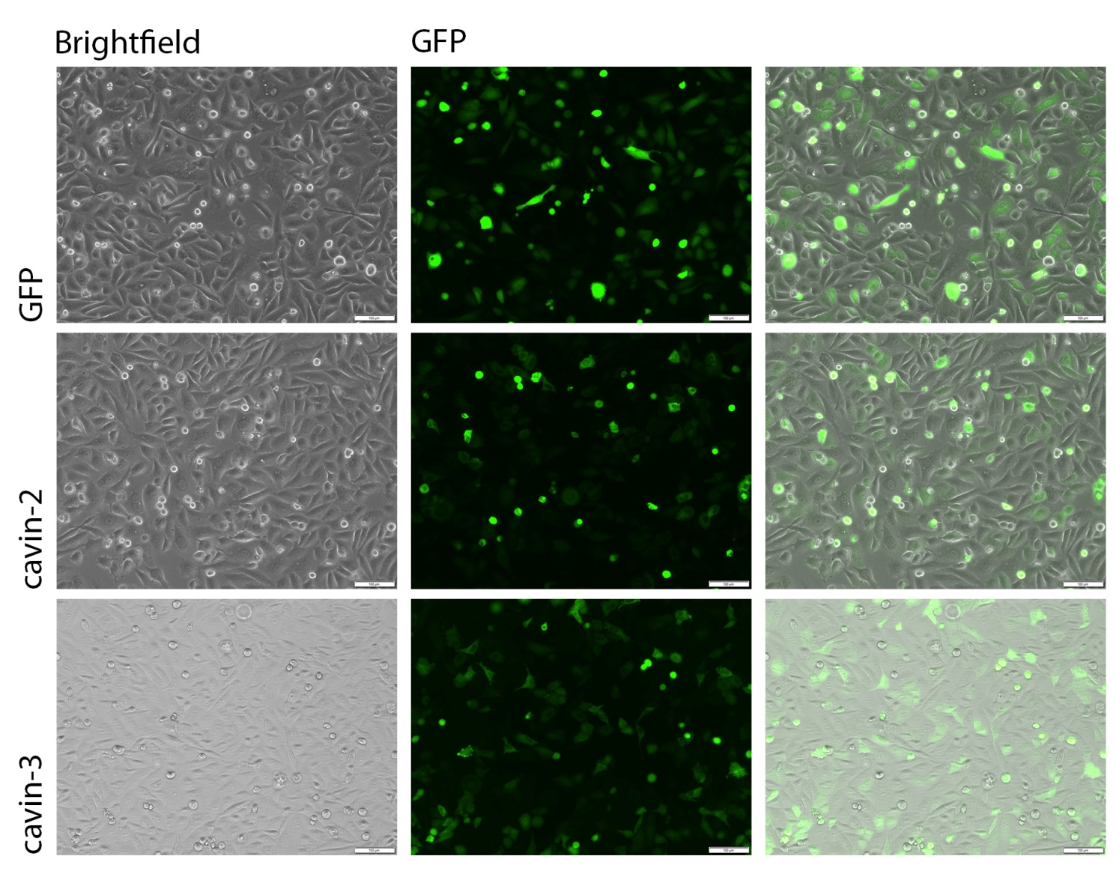
PC3 shCAV1 cavin transfection
Caveolin-1 knockdown
Cavin-1 negative

Slide 13
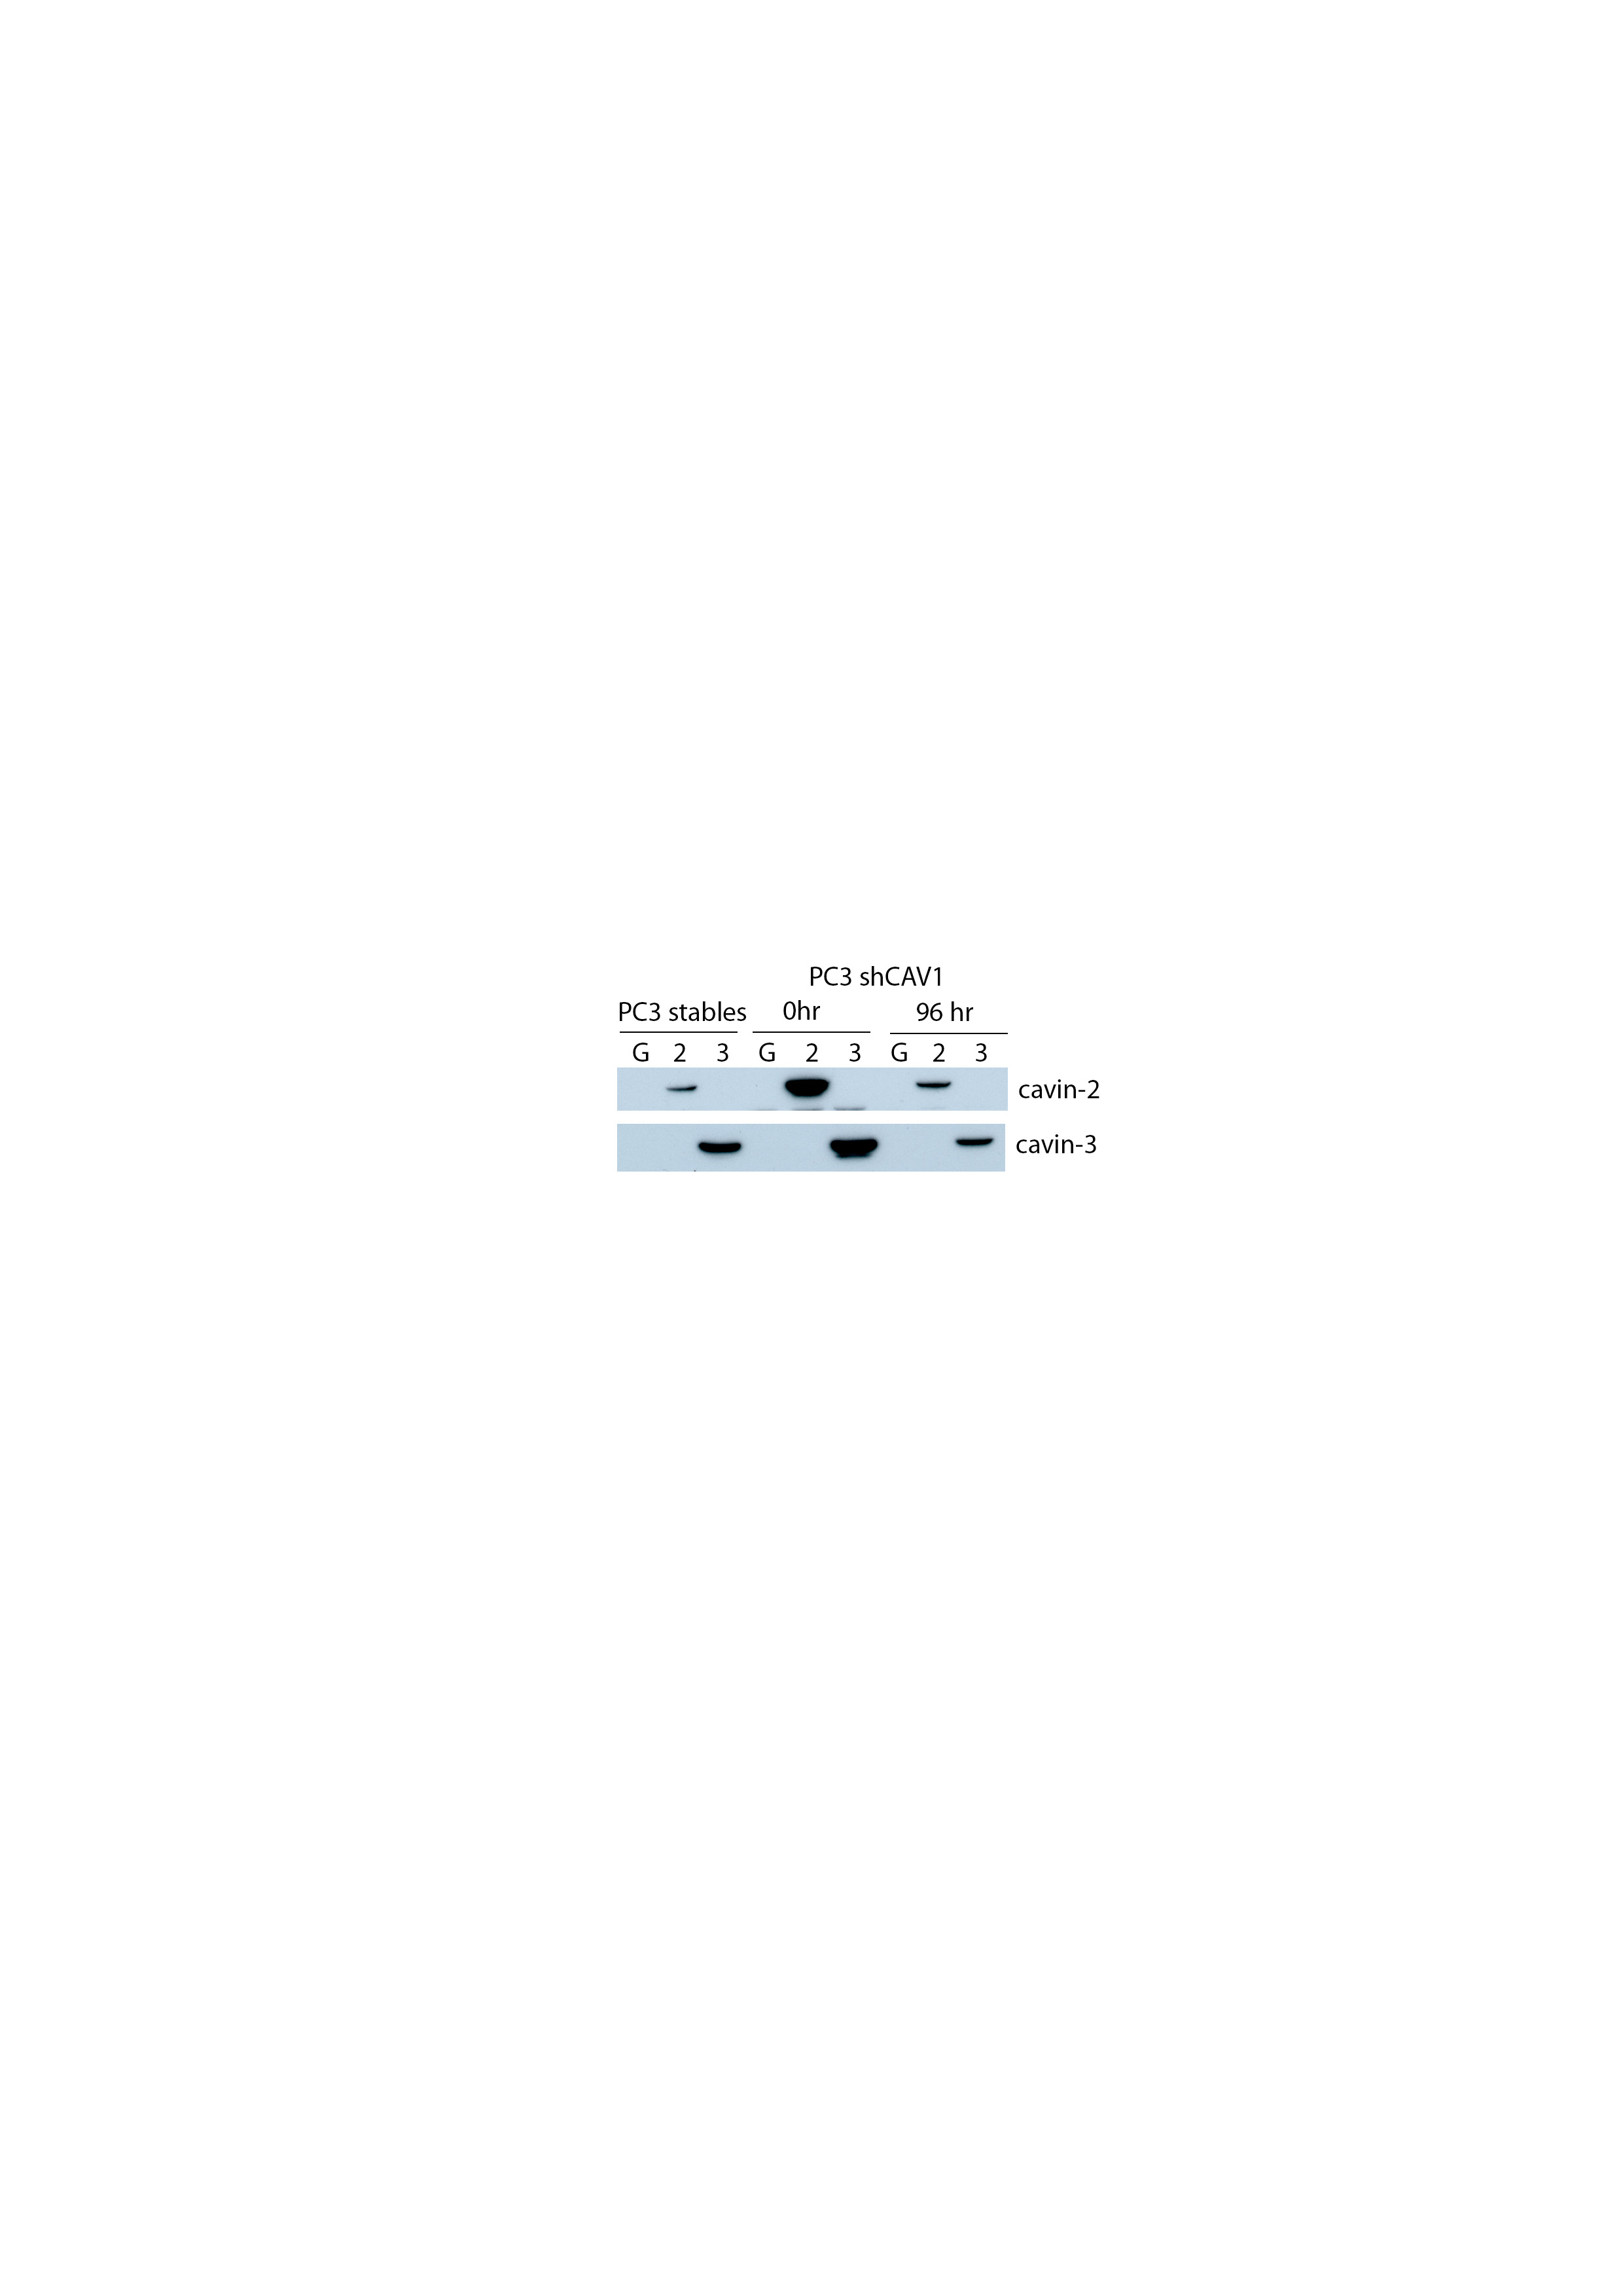
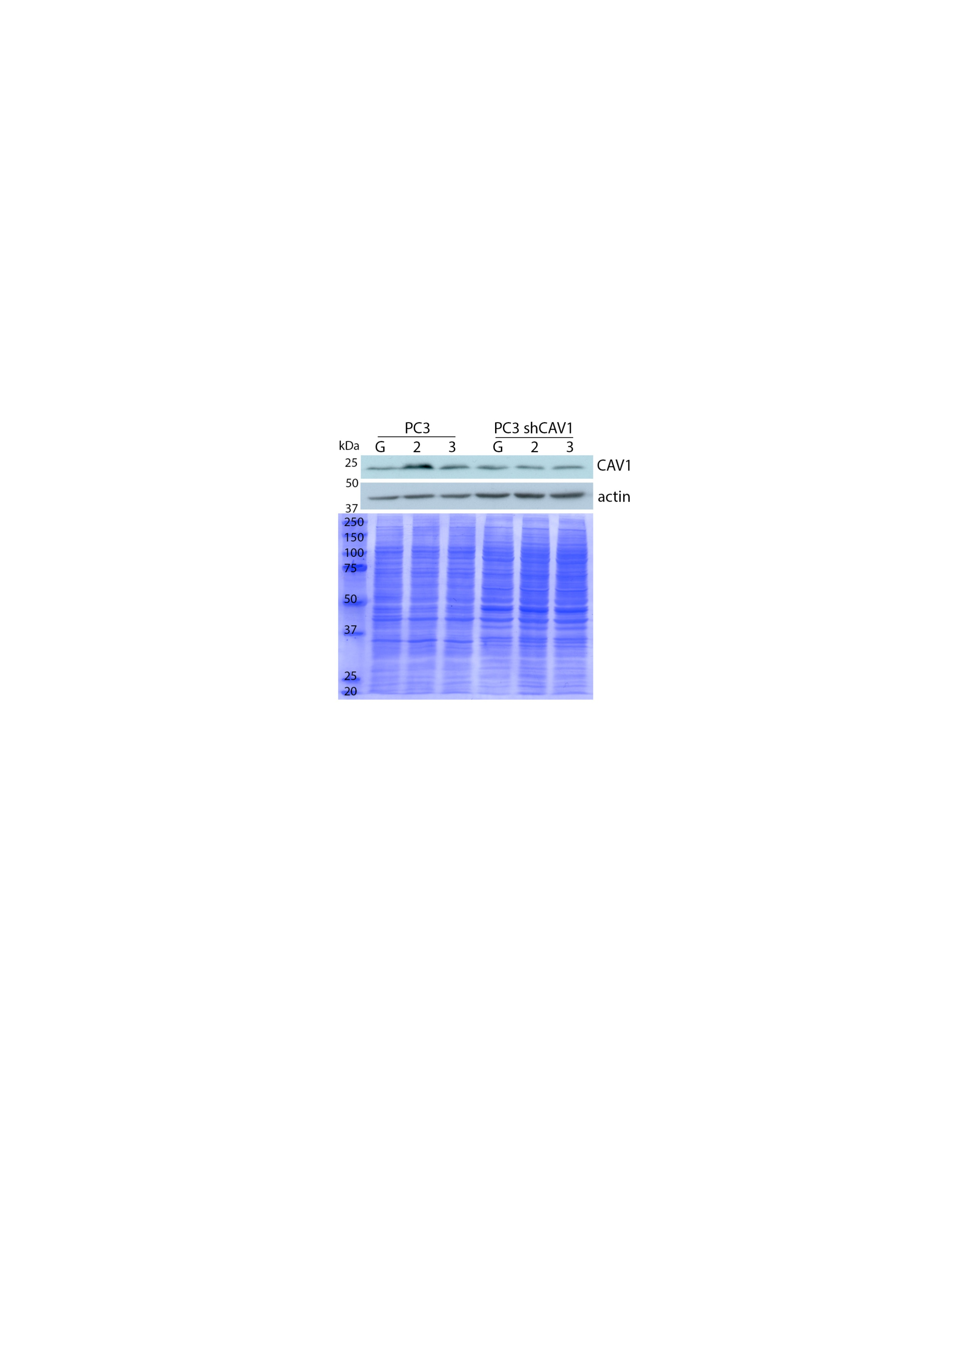
PC3 shCAV1 cavin transfected proliferation
Caveolin-1 knockdown
Cavin-1 negative

Slide 14
Decreased proliferation in PC3 cells
Harriet &
Sunny
Caveolin-1 positive
Cavin-1 negative

Slide 15
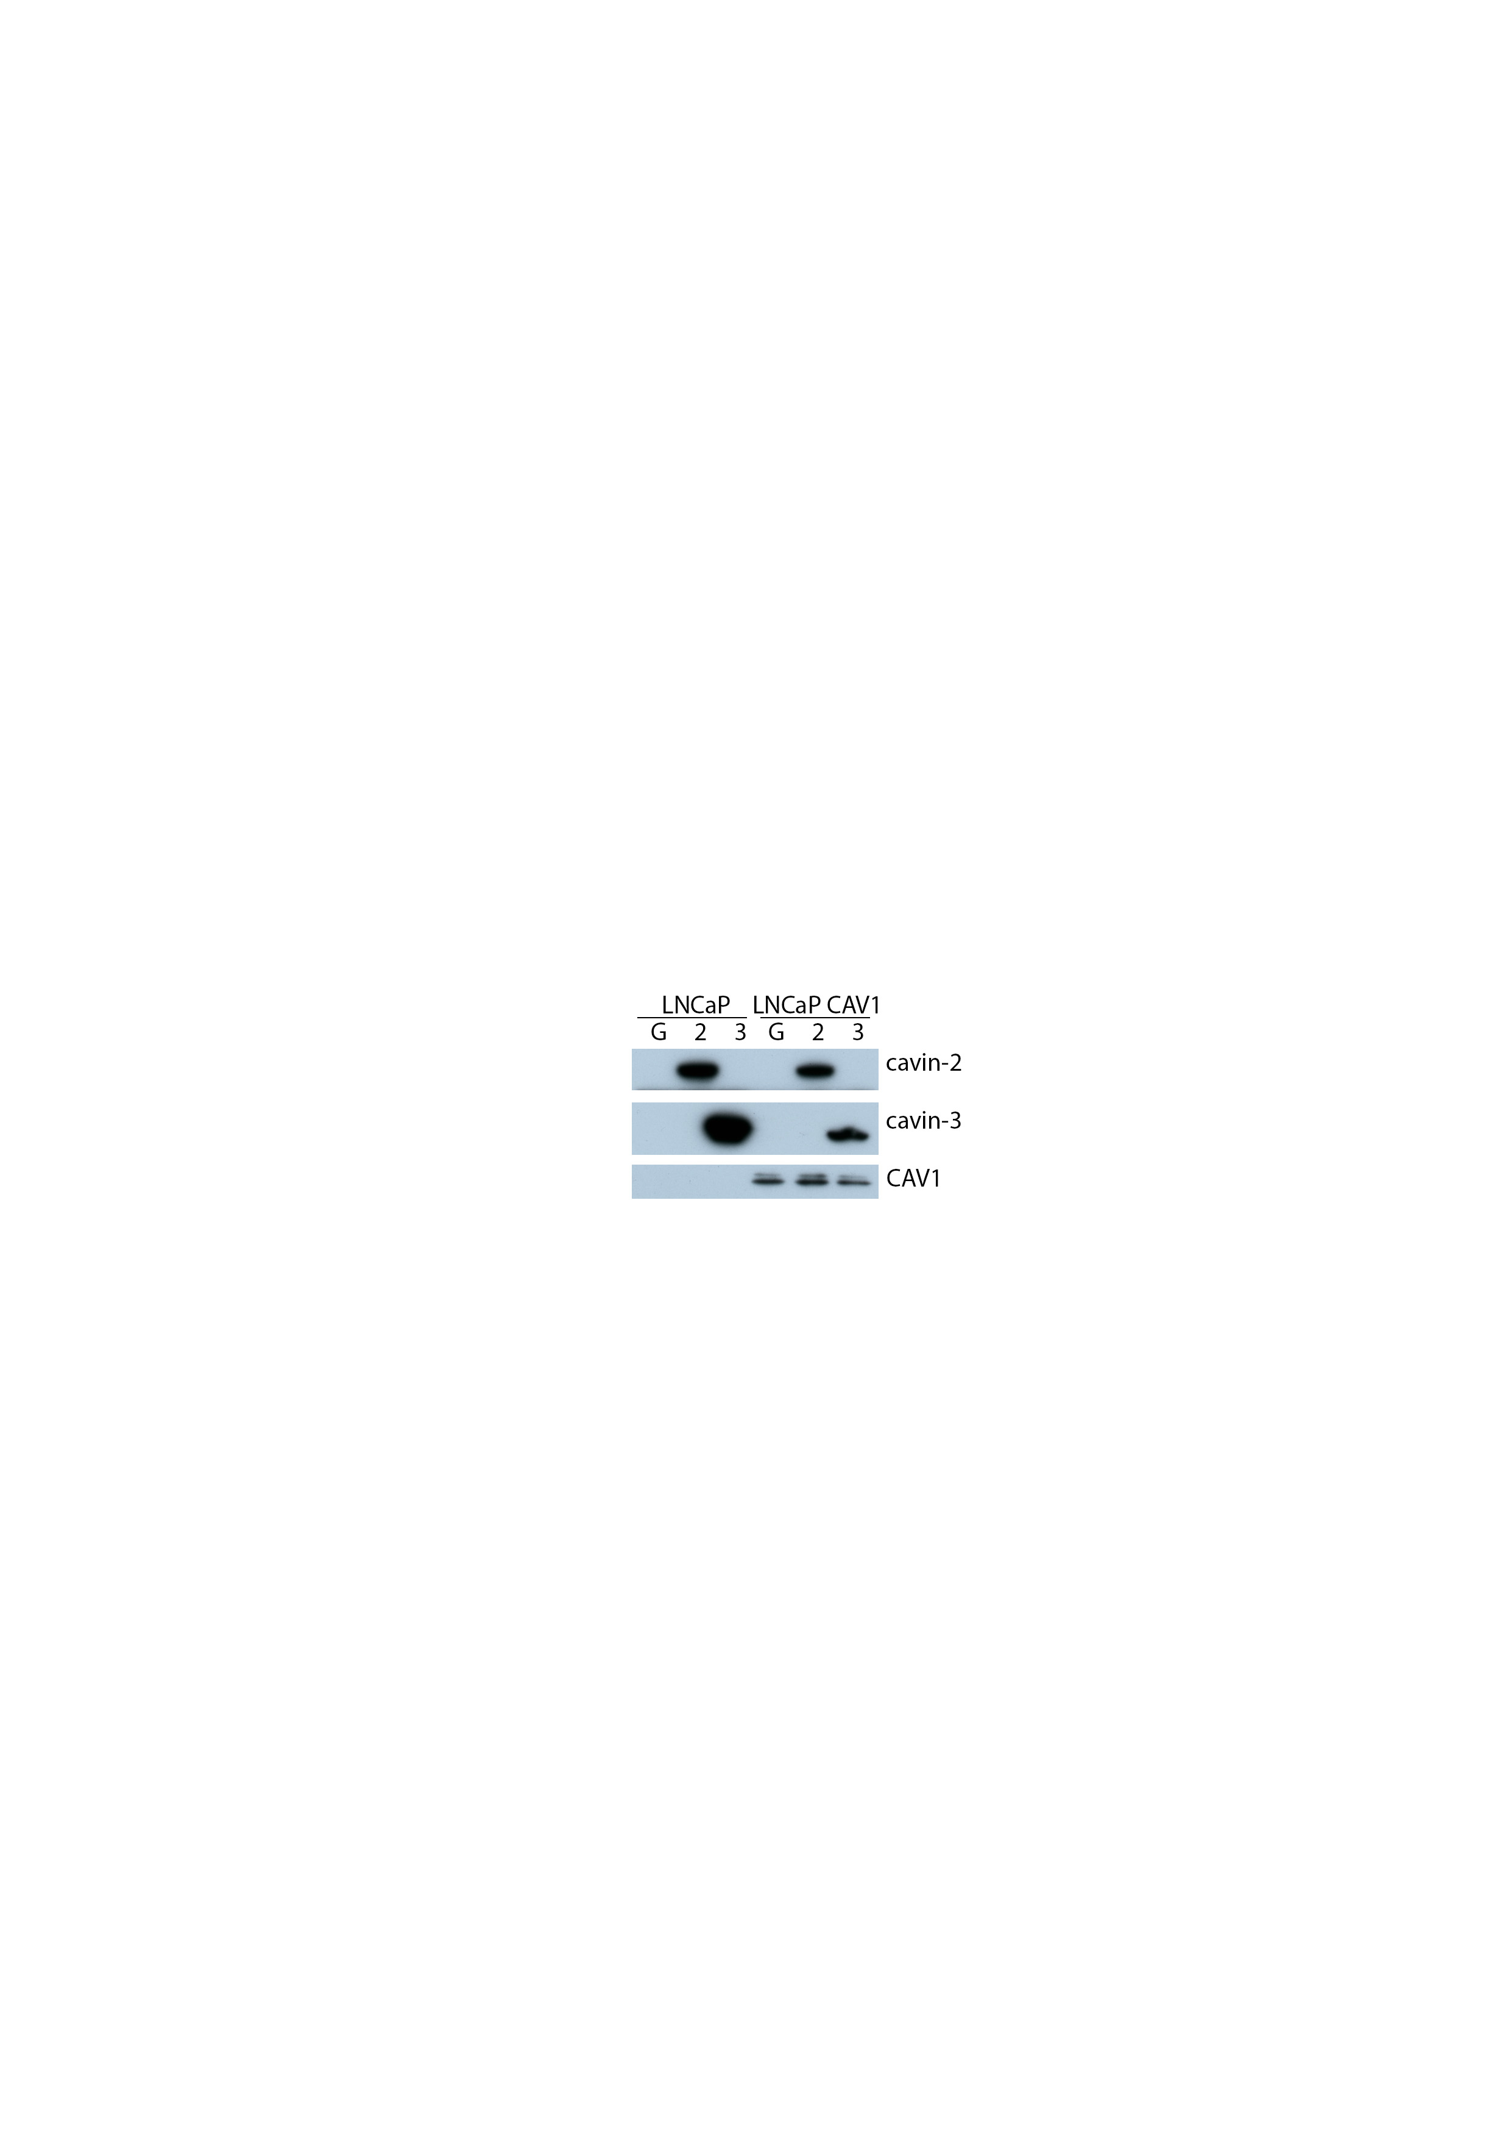
LNCaP caveolin-1
from 1 replicate
Caveolin-1 positive
Cavin-1 negative

Slide 16
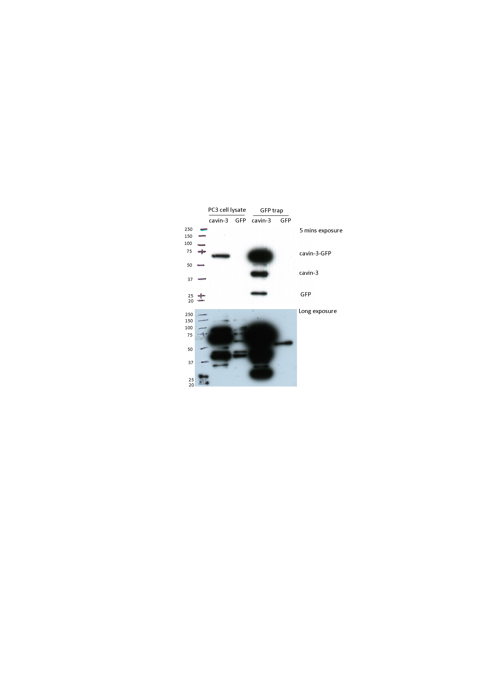
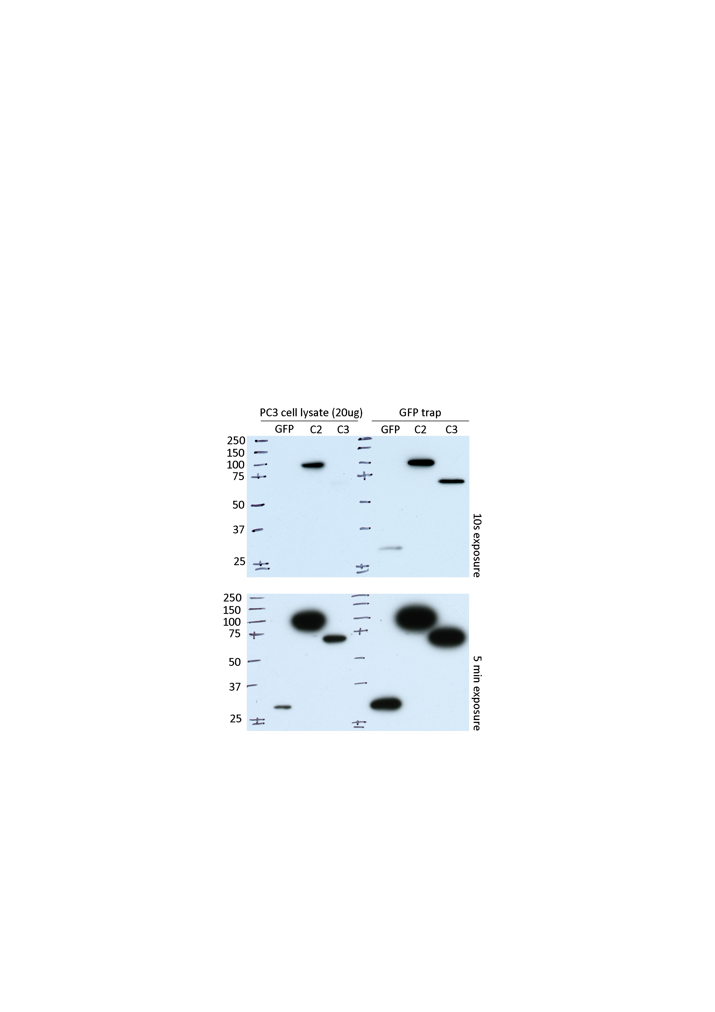
GFP trap
Before FACS sorting
After FACS sorting

Slide 17
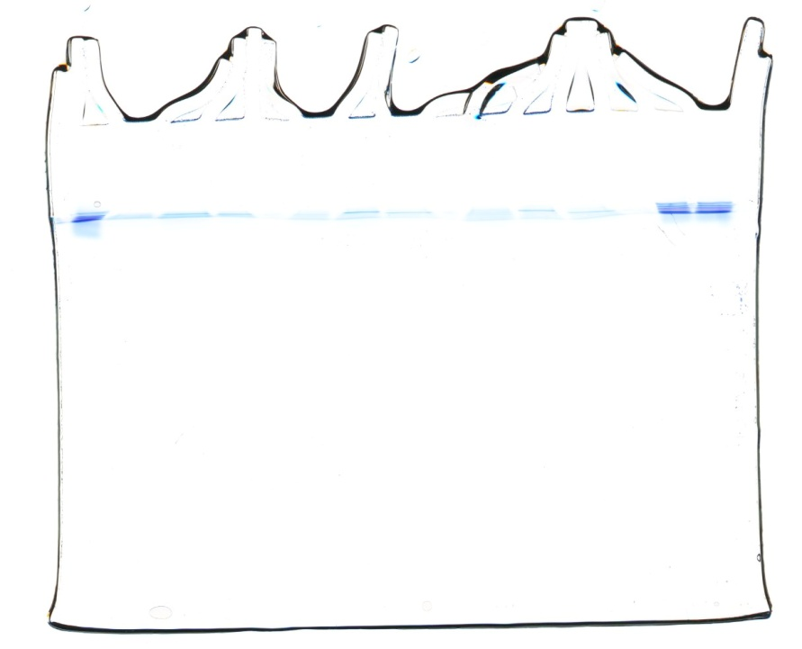

GFP trap – Mass spec (QTOF)
SDPR (cavin-2) identified in all cavin-2 samples
PRKCDBP (cavin-3) identified in all cavin-3 samples
Pleckstrin identified in cavin-2/SDPR sample
L G 2 3 G 2 3 G 2 3 L L
Rep 1 Rep 2 Rep 3

Slide 18
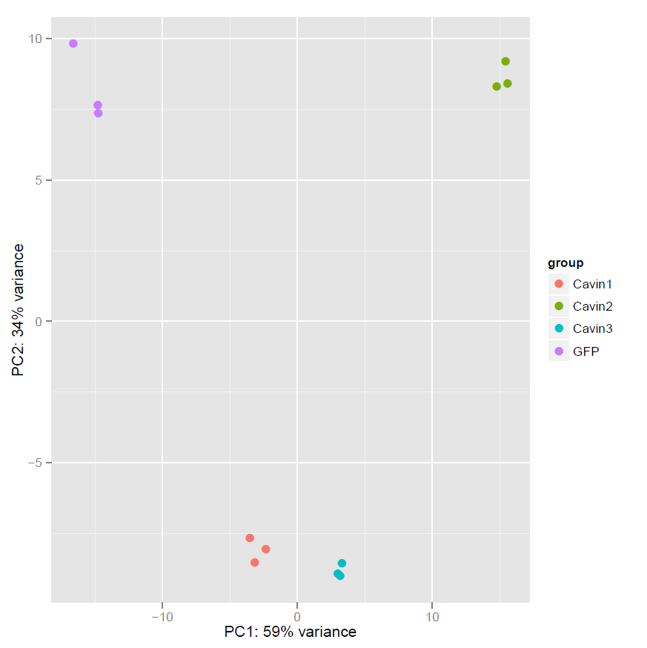
Transcriptomics
Most significant changes in transcripts for proteins involved in secretion (both cavin-2 and -3)
TMPRSS4 downregulated by both cavin-2 and cavin-3

Slide 19
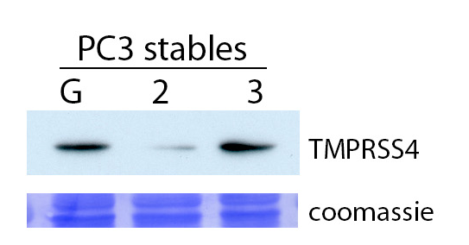
TMPRSS4 blot
Transmembrane protease
Involved in epithelial-mesenchymal transition, migration, invasion and metastasis
In prostate cancer expression is higher than adjacent non-cancerous tissue
↑ expression in pancreatic, thyroid, lung and colorectal cancers

Slide 20
miRNA seq
miRNA sequencing from GFP, cavin-1, cavin-2 and cavin-3 PC3 cells

Slide 21
miRNA seq
miR363-3p
Down regulated by cavins – tumour promoting?
Unknown function
↓ in gastric cancer, clear cell renal cell carcinoma (ccRCC) and colorectal cancer
↑ in adenocarcinoma of the uterine cervix
miR574-5p
Upregulated by cavins
– tumour suppressor?
Supressor of metastasis in colorectal cancer (negative regulation of MACC1)
↑ in lung cancer down-regulating checkpoint suppressor 1 via TLR9 signalling
Enriched in extracellular vesicles from colon cancer cells
miR574-3p implicated in cancer (↓ colorectal cancer x2, ↑ osteosarcoma and HNSCC x2)

Slide 22
Future directions
Orbitrap for GFP-trap samples
Proteomics on secreted proteins
Validation of miR-363-3p and miR-574-5p levels by qPCR

Slide 23


